Slide 1
Using Ecto (without db) for validating form
By Ohhi.vn

Slide 2
Agenda
Intro team & me.
Ecto Schema & Changeset.
Phoenix form.
Ecto + form.
Demo.
Q & A.

Slide 3
About team & me
Team Ohhi.vn:
Start to target to Elixir ecosystem.
Work with Erlang, experienced with OTP framework.
Work an interesting project and have a plan to bring it to people.
Me:
Worked in antivirus & ransomware softwares.
Worked with big data & high performance system.

Slide 4
Introducing Ecto
Ecto is a very flexible library for working with relational database in Elixir.
Main parts of Ecto:
Repo
Query
Schema
Changeset

Slide 5
Common use case
User code
Repo/Query
Ecto
DB
Changeset
Schema

Slide 6
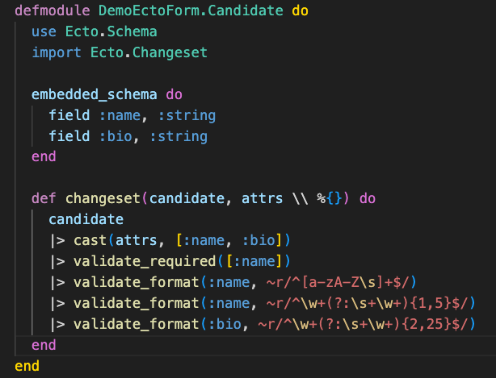
Intro Ecto - schema
Declare table.
Wrap record & fields.
Add metadata.

Slide 7


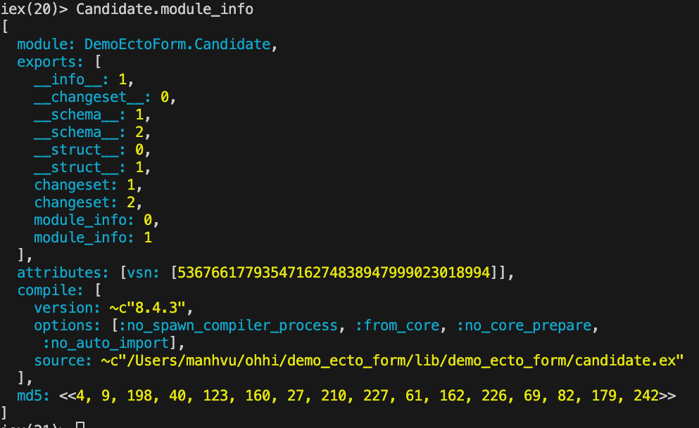

Slide 8
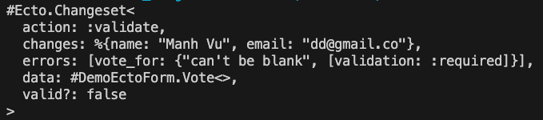
Intro Ecto - Changeset
A struct for hold user record, changed data, metadata.
Has functions: filter, validate, casting, apply an action,...
Can use with map (without Ecto query, repo & schema).

Slide 9
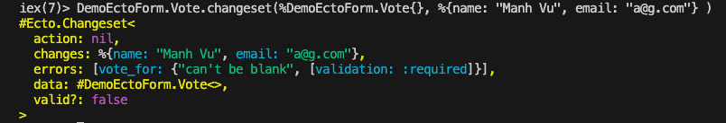
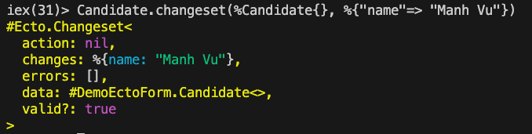

Slide 10
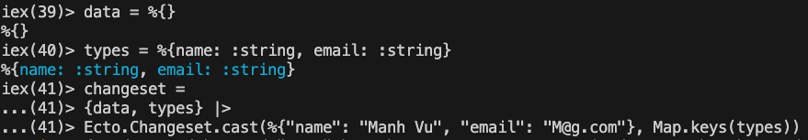
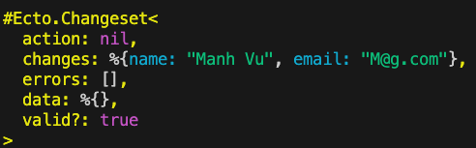
Changeset without schema
We can use changeset with map (for case you want to build custom data type)

Slide 11
Phoenix HTML form
A predefined Phoenix component for work with HTML form.
Provide events for LiveView.
Easy to a make a form with Ecto/map or custom data.

Slide 12
Form - implement
Phoenix implement HTML form in Phoenix.HTML.{Form, FormData, FormField} & Phoenix.Component for user uses template with form.
Support Map & Ecto.Changeset, user can implement a protocol for custom data.
HEEx engine (EEx engine) will execute code in runtime to map user data to template.

Slide 13
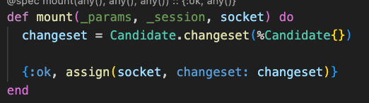
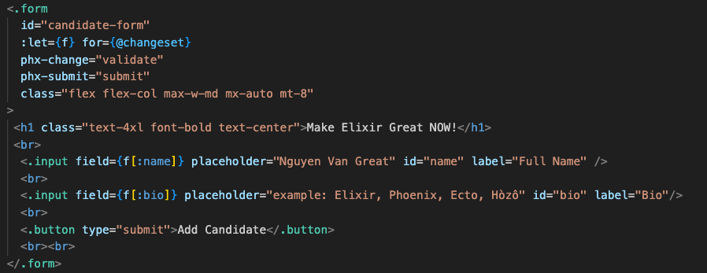
How the form is used in Phoenix
Pass data to socket in mount/handle_event.
Declare form in template.

Slide 14
How form is validated?
Validated at server side by user code.
For regular page data will be validated at submit time.
For LiveView data can be validated when data change in input or submit time.

Slide 15
How Phoenix form support Ecto
Implement a protocol (Phoenix.Ecto lib) to convert data from Ecto.Changeset to Phoenix.FormData (similar for Ecto Decimal & Exception).

Slide 16
Form in LiveView & benefits
Can validate while user is typing (realtime).
Easy restore state of form (cases: LiveView is crashed, user reload page/go to other device).
Suggesting/auto complete directly in form.

Slide 17
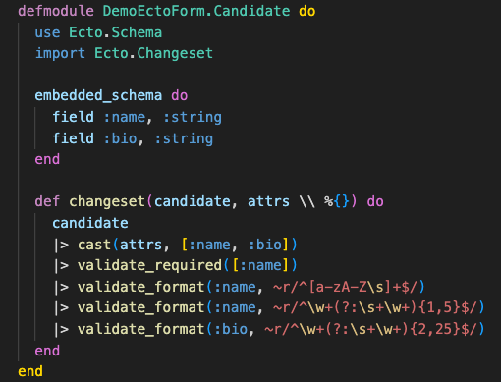
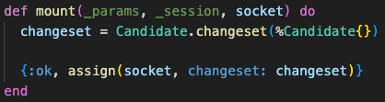
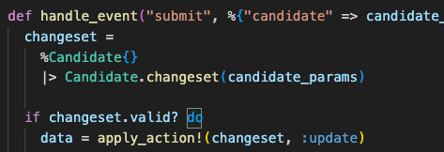
Two Ecto modules are enough for working with form
Ecto.Schema & Ecto.Changeset are enough for integration to Phoenix form.

Slide 18
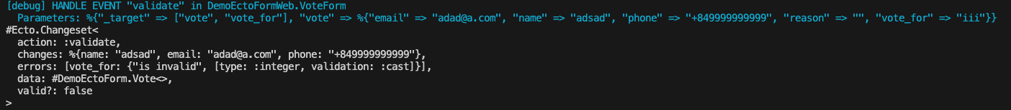
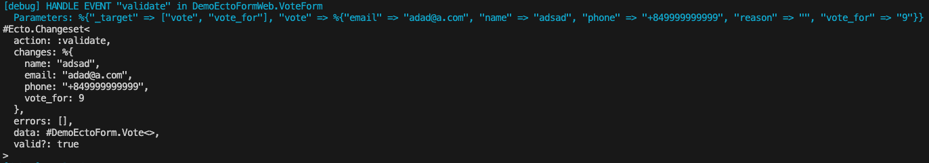
Changeset struct after cast & validate
Validate failed:
Validate successful:

Slide 19
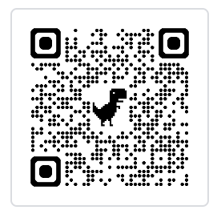
Demo
Source code is available on Github.com/ohhi-vn/sharing_ecto_form
User View
LiveView Process
ETS table
Ecto (validate, cast)

Slide 20
Recommended docs
Phoenix.{HMTL, Ecto, Components} docs
Ecto.{Schema, Changeset} docs.
The Little Ecto Cookbook (free - Dashbit).
Ecto Without a DB - Greg Vaughn talk on Youtube: https://youtu.be/k_xDi7zAcNM

Slide 21
Q&A!
Thank you for listening!

